Slide 1
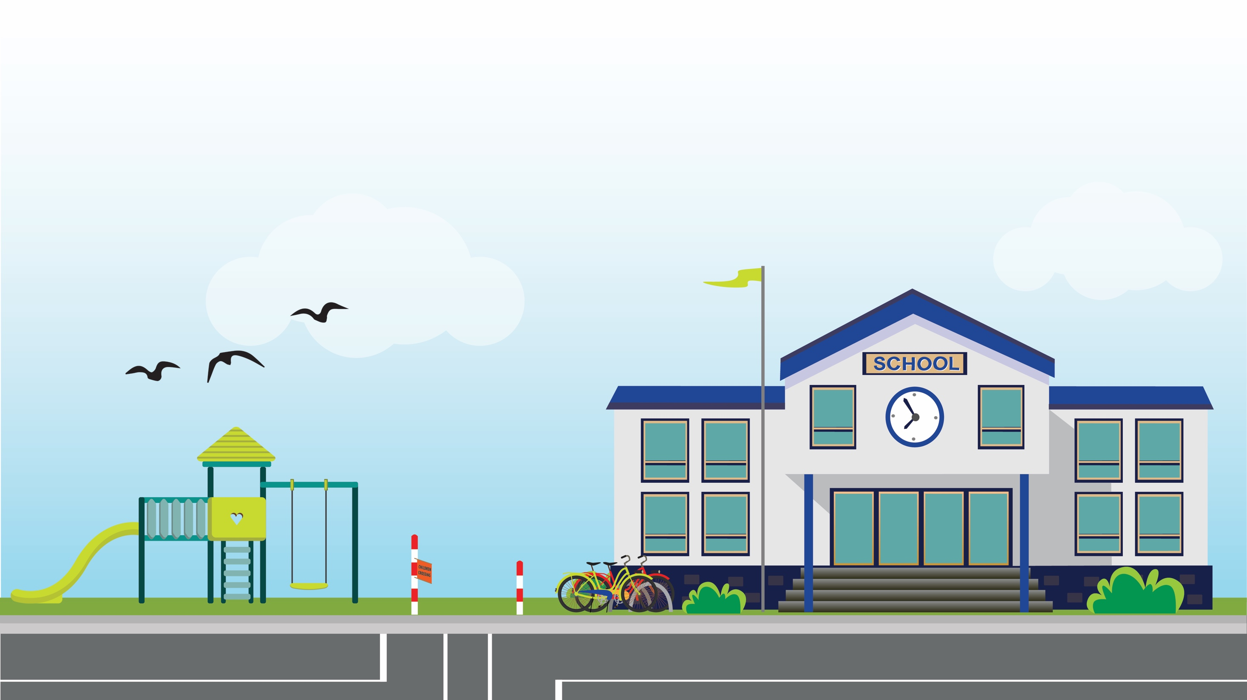
Thinking about what makes a place safe

Slide 2
Photo activity
Look at the following photos …

Slide 3
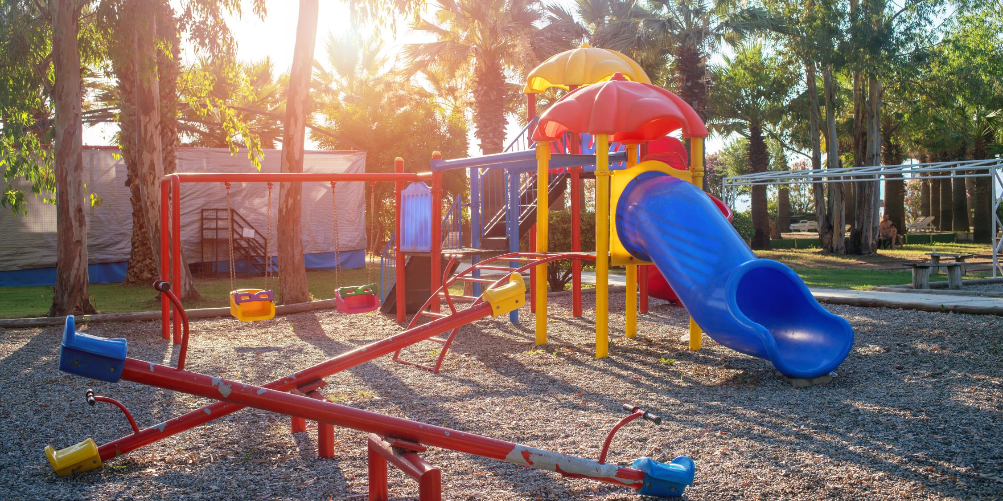

Slide 4
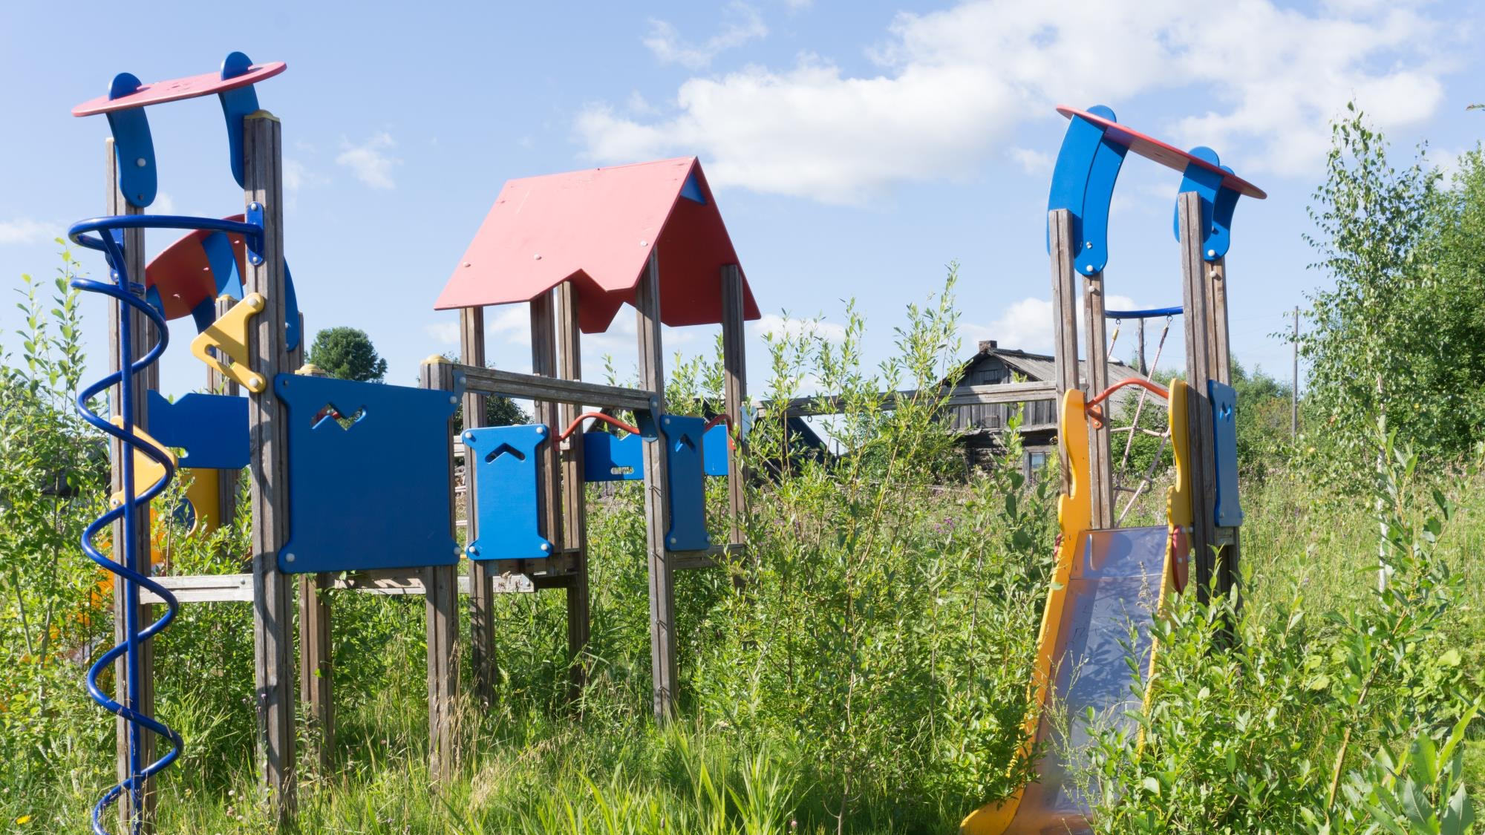

Slide 5
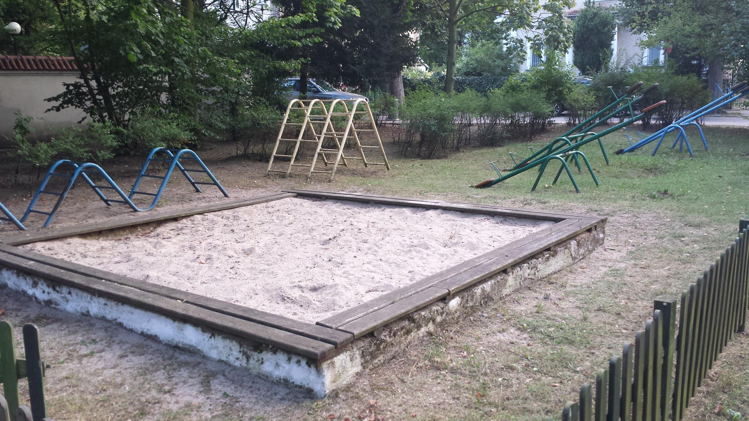

Slide 6
In groups of 3 or pairs, discuss
How do you feel after looking at these photos?
How might you feel if these were your playgrounds?

Slide 7
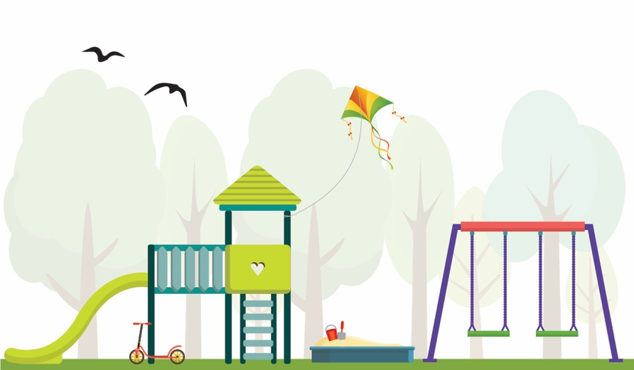
In groups of 3 or pairs, discuss
What do you notice in each of these photos?
Which playground would you want to play in?

Slide 8
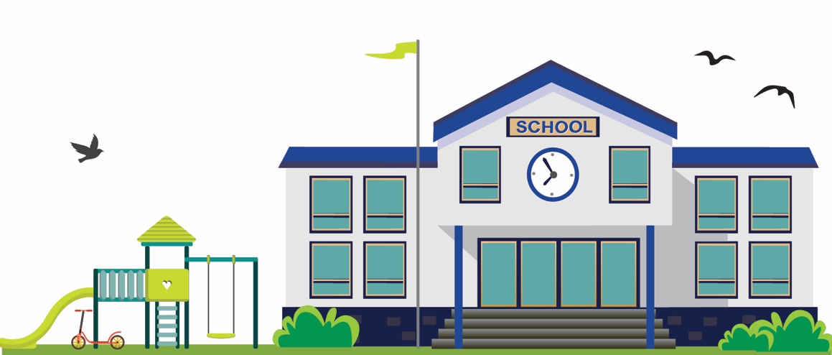
In groups of 3 or pairs, discuss
Which playground would you feel safer in?
What makes a school playground a safe place to play?

Slide 9
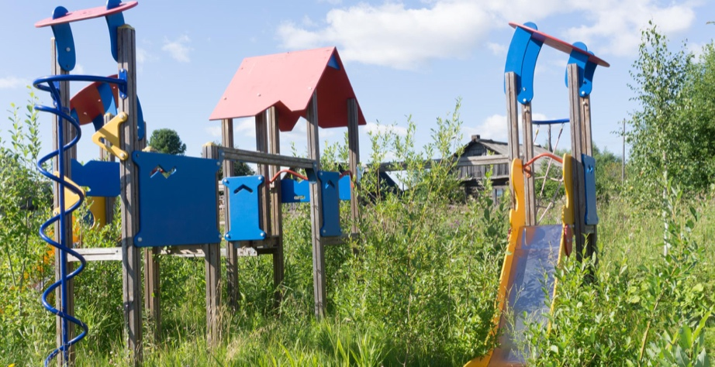
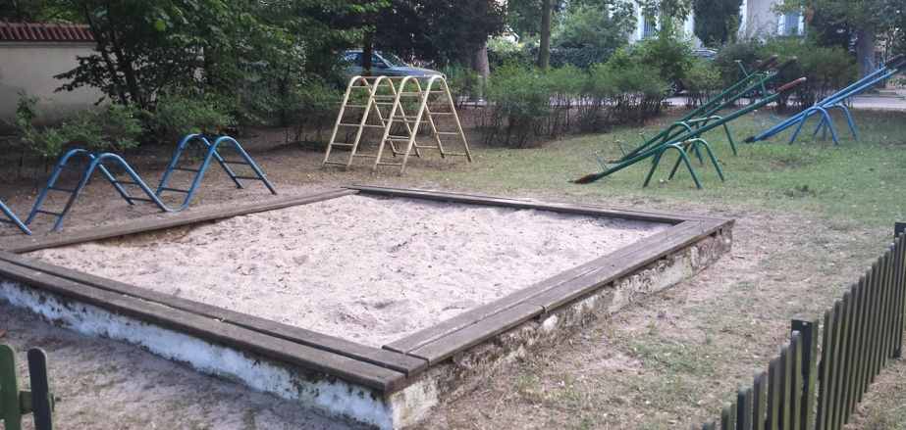
[Recap]
In groups of 3 or pairs
Discuss all the feelings you have after viewing these photos
How might you feel if these were your playgrounds?
Describe what you notice in each of these photos
Which playground would you feel safer?
What makes a school playground a safe place to play?

Slide 10
Drawing activity
Watch the following video …

Slide 12
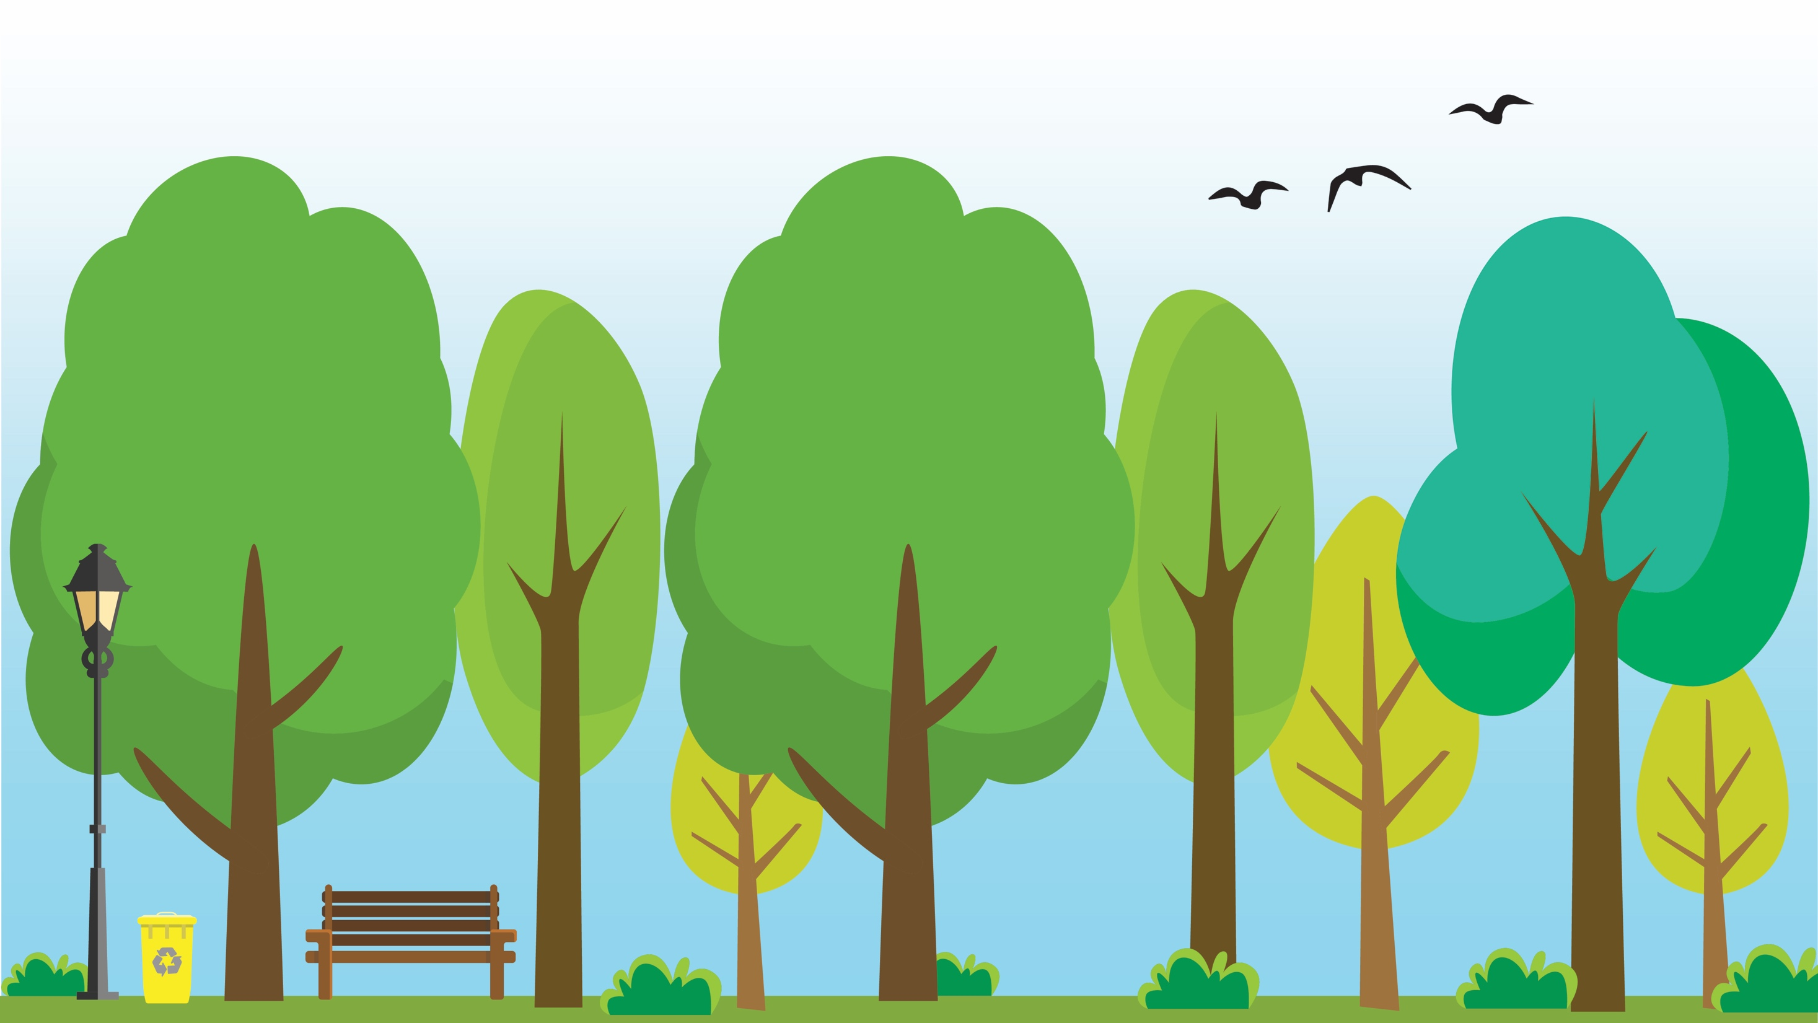
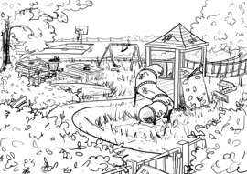
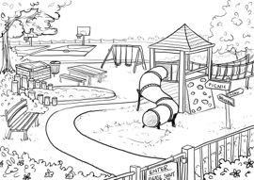
As a class, discuss
What has happened to the park over time?
Does it feel safe?

Slide 13
Drawing an imaginary school yard
Divide the class in half
Half of the class draws a “safe yard”
Half of the class draws an “unsafe yard”

Slide 14
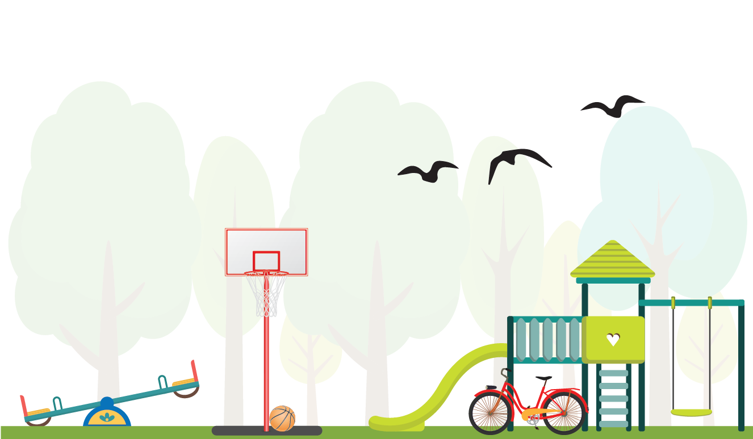
After looking at the illustrations
How do the school yards make you feel?
What could be done to increase your feelings of being in a safe place?
I feel safe when …
I feel unsafe when …

Slide 15
What makes a safe place
When designing a safe place, there are 4 things to think about …

Slide 16
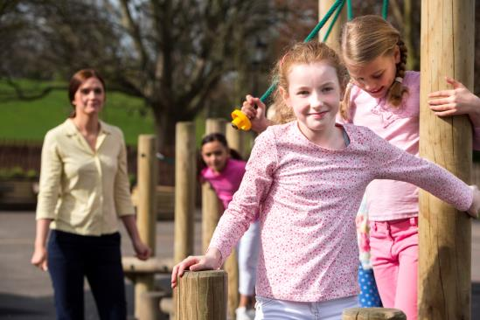
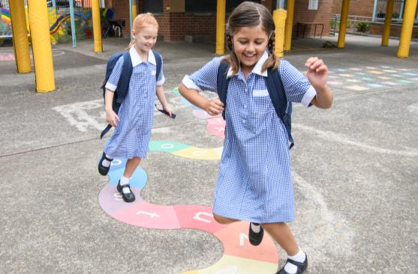
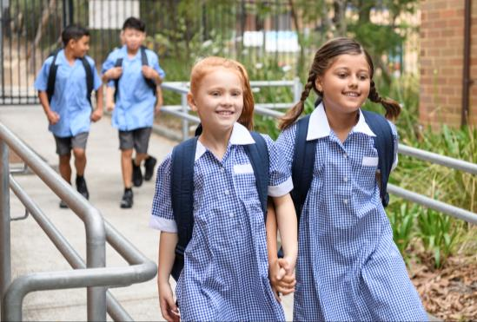
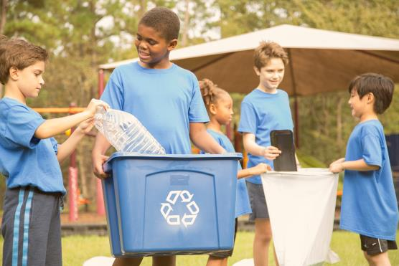
Match the photos with each principle
Coming and going
how do people move around an area
What signs, gates, fencing, landscaping, and paths are there to welcome, and help people find their way around confidently; or to stop people from entering private or dangerous areas?

Slide 17
Match the photos with each principle
Keeping watch
how do people watch over an area
Is the area in full view so people can keep an eye on it easily?
Are trees and bushes trimmed?
Is there good lighting?

Slide 18
Match the photos with each principle
Showing we care
how do people look after an area
Is the area clean and well maintained?
Are broken windows and lights fixed?
Rubbish bins emptied?
Graffiti tagging cleaned up?

Slide 19
Match the photos with each principle
Having fun
how do people use an area in positive ways
Is there play equipment?
Picnic tables and benches?
Sporting facilities?

Slide 20
Were you correct?
[Answer]
[Answer]
Coming and going
Keeping watch
[Answer]
[Answer]
Showing we care
Having fun

Slide 21
The How safe is my school resources have been developed in partnership between Neighbourhood Watch Victoria and RACV.

